Slide 1
Welcome to the Employee Q&A February 7, 2019

Slide 2
Budget Reduction in These Areas
Communications & Marketing
Philanthropy, Development, Alumni
GRAMAR
Chapel Apprenticeships, Vocation & Formation, Student Engagement & Success
Korean Studies Center, Centro Latino, Pannell Center, Asian American Center
DMIN & DMISS
Library
Information Services
Human Resources
Travel & Hospitality

Slide 3
Questions
How do you do your service differently?
Where are there cost efficiencies? Innovations?
Look across departments. What do we have in common?
What are the implications?

Slide 4
Timing
Email Worksheet – February 2019
Follow up Meeting – February 2019
Worksheet Due Date: March 8, 2019
Phase in reductions over the next couple of years

Slide 6
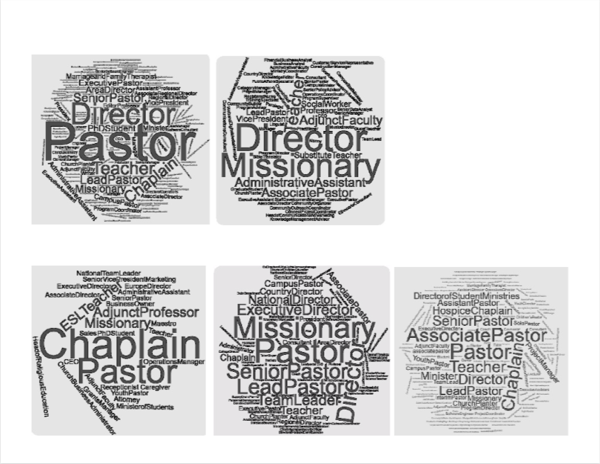

Slide 7
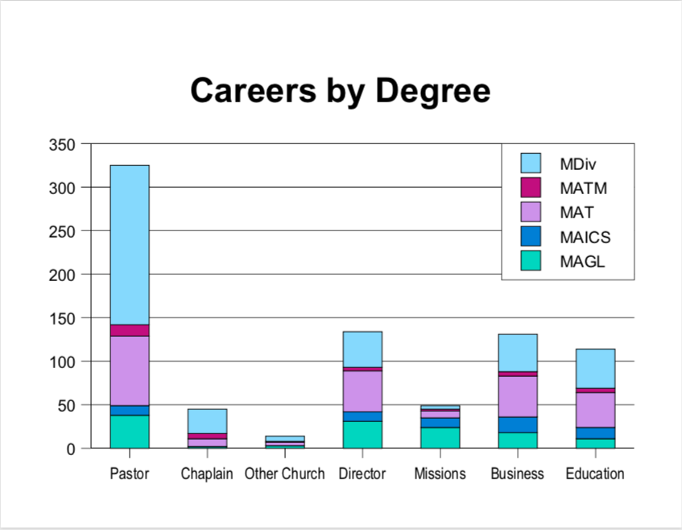

Slide 8
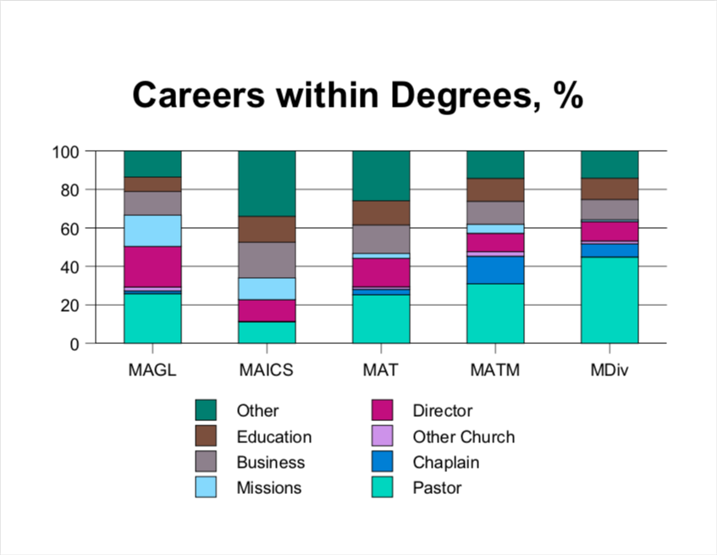

Slide 9
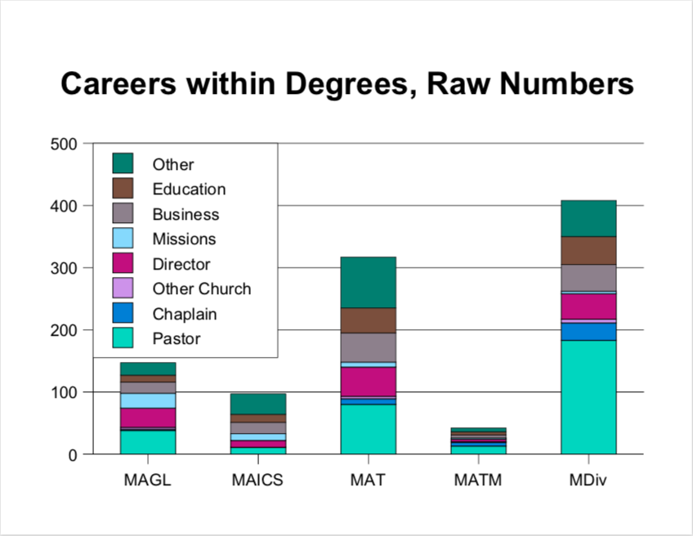

Slide 10
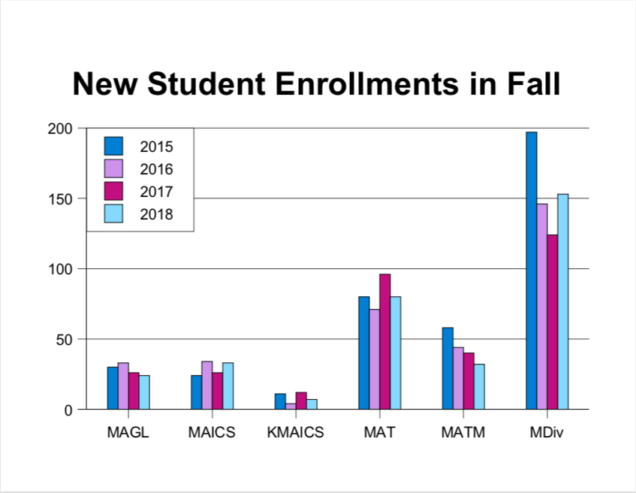

Slide 11
